Slide 1
Mouse Controls 2 – Mouse Motion

Slide 2
Mouse Motion
Pygame registers a mouse motion event every time the mouse moves regardless of any buttons being pushed/released
  If the mouse moves a lot, this can result in may events being generated!
  Pygame is designed to handle these events, but be aware erratic mouse movements may result in choppy responses

Slide 3
Using Mouse Motion in Pygame
Each time a MOUSEMOTION event is created, Pygame registers the following information:
  Where the current location of the mouse is on the screen

Slide 4
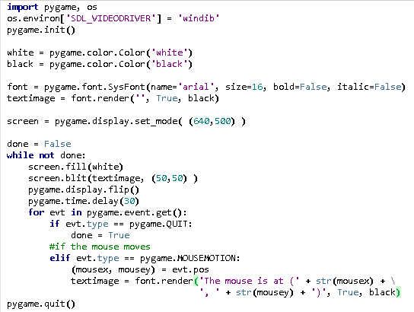
Example 1 – Tracking the Mouse

Slide 5
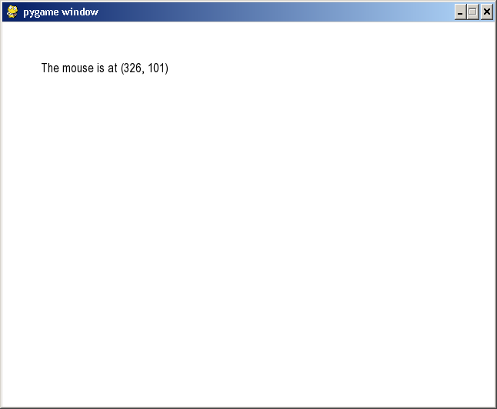

Slide 6
Example 2 – Dragging Items
To effectively simulate dragging, you have to do the following:
  Each time a mouse is clicked on an object, enable it to be moved
  Each time the mouse moves when an object is “clicked”, update the position
  Disable the object to be movable when the button is released

Slide 7
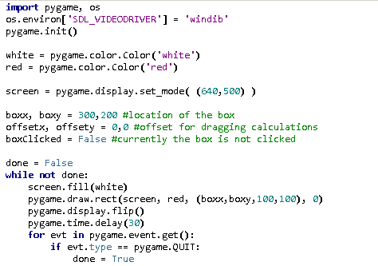
Example 2 – Dragging Items

Slide 8
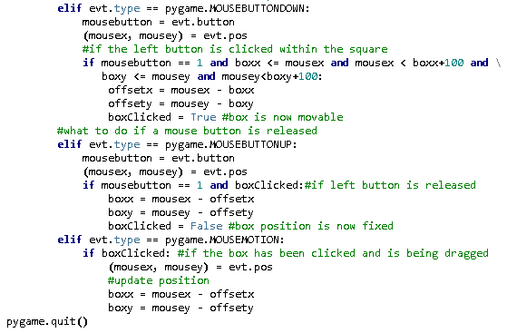

Slide 9
